Slide 1
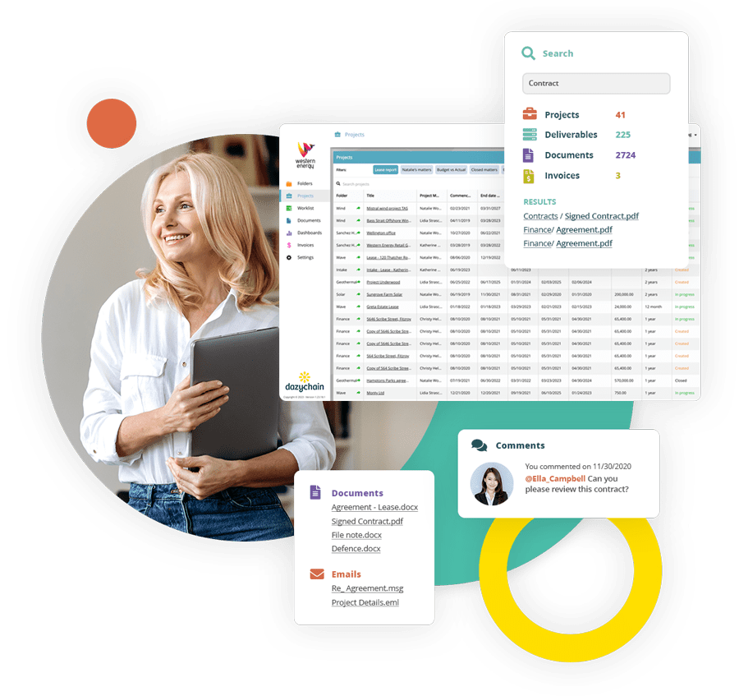
Dazychain
Business Case

Slide 2
Executive summary
Purpose
The purpose of this presentation is to provide a business case to purchase Dazychain matter management software.
Current challenges
Proposed solution
The in-house legal department is currently facing challenges managing the growing volume and complexity of legal matters
Existing methods of matter tracking is manual and disjointed, creating risk
To address these issues and improve productivity, we propose investing in Dazychain Legal Matter Management System (LMS) to:
Streamline and centralize matter and document management
Improve efficiency and service delivery
Facilitate rapid decision-making

Slide 3
Current challenges
Manual processes
Lack of visibility
Compliance risks
Fragmented data
Legal matters are managed through spreadsheets, email communications, and paper-based files, leading to work duplication, lost information, missed deadlines, and high administrative overhead
Internal clients engage the legal team repeatedly through various channels for briefing and status updates with repetitive, simple requests
There is insufficient visibility into the status of ongoing matters, risks, and legal spend, making it difficult for management to make informed decisions or allocate resources effectively
No visibility of resource allocation, workload, output, risk ratings, due dates, or status
The manual tracking of legal deadlines and compliance milestones increases the risk of missed deadlines or non-compliance
Previously requested advice is requested again from external counsel
Matters and documents are stored in disparate folders and inboxes making information difficult to locate, retrieve and access
The Legal team can’t access documents, correspondence, and matter history, reducing the time available for legal work

Slide 4
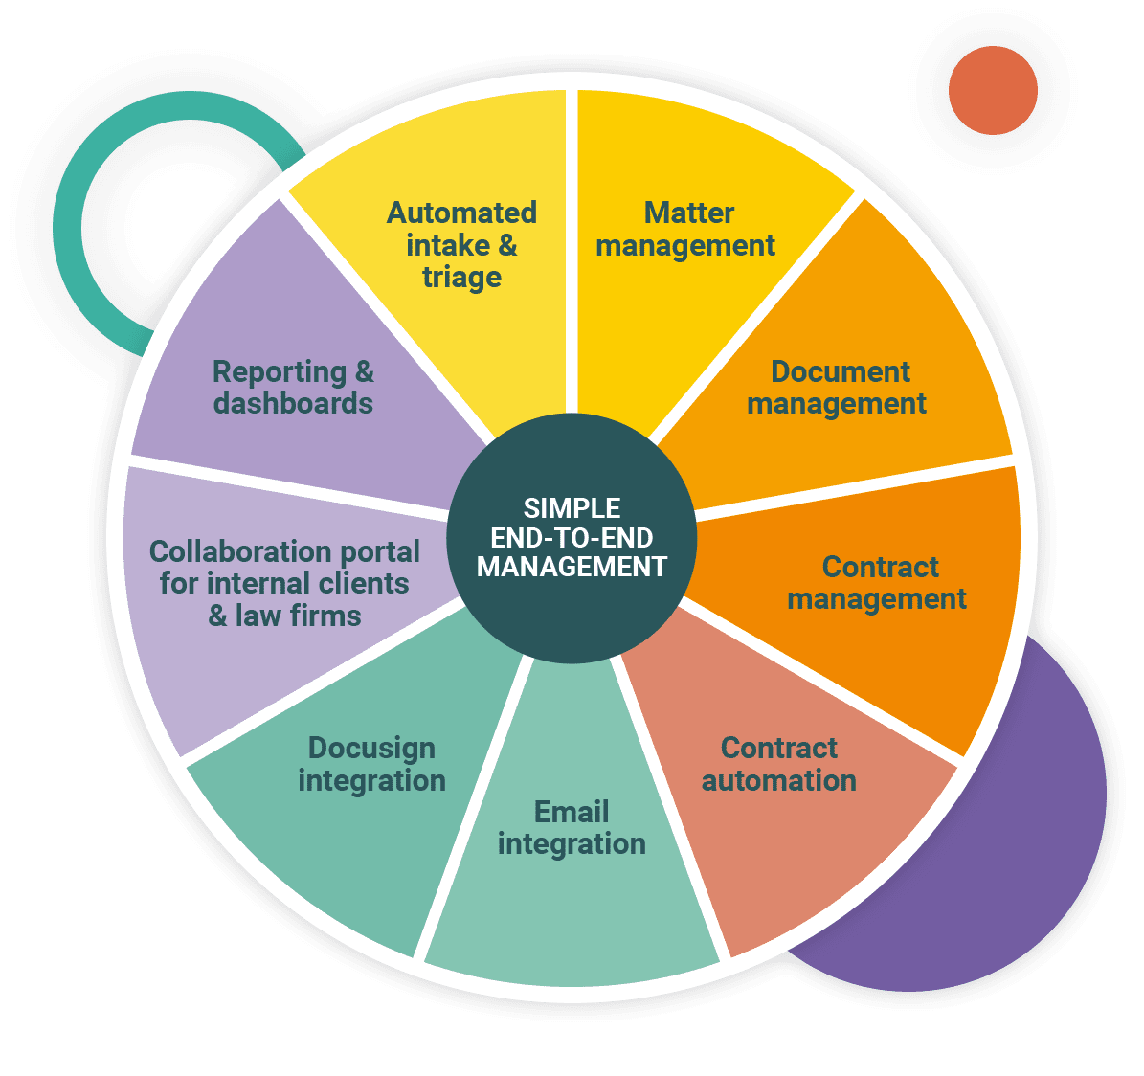
Solution requirement
Key components of the solution
Cloud-based with a secure, encrypted environment for legal data
A simple, intuitive interface
Configurable to enable business workflows and reporting
Integrations with Microsoft Suite and DocuSign
Reputable vendor with proven expertise in the legal tech space
To address the current challenges and realize the identified opportunities, the proposed Legal Matter Management System needs the functionality shown below.
Required system features
Intake
Matter management
Document management
Contract management
Contract automation
Reporting and analytics
Microsoft and DocuSign integrations
Compliance and risk management

Slide 5
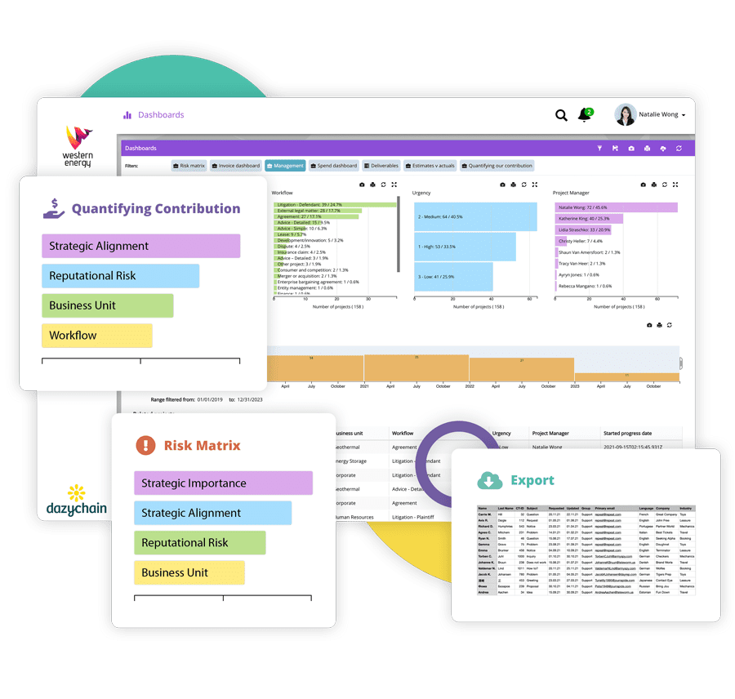
Solution proposal:
Dazychain matter management
1
Automation
Configurable workflows for intake, matter creation, contract creation, task assignment, document approval, and reporting.
2
Dashboards and reports
Real-time, customizable dashboards and reports to track legal spend, matter progress, and team productivity, providing actionable insights.
3
Contract management
Automated reminders for key milestones, tasks, end dates and legal deadlines to ensure timely action on all matters and contracts
4
Document management
Secure, centralized storage for contracts, advice, and correspondence with version control, enabling document sharing and reuse.

Slide 6
Benefits
Increased efficiency
Reducing the time spent on administrative tasks by automating workflows and centralizing matter information, enables the legal team to focus on strategic and high-value work.
Cost reduction
Significant savings through improved resource allocation, the reuse of advice and knowledge, reducing reliance on external counsel for routine matters, and minimizing the risk of missed contract deadlines.
Better decision-making
Real-time reporting and analytics provide insights into the performance of the legal department, helping to make data-driven decisions regarding resource allocation, legal strategy, and budgeting.
Scalability
The system easily scales with the company’s growth, ensuring continued efficiency and effectiveness as the volume of legal matters increases.
Improved risk management
Automated compliance and deadline tracking mitigates risks related to legal and regulatory non-compliance, potentially avoiding costly fines.
Enhanced collaboration and communication
Centralized contract and document management improves coordination between the in-house team, external counsel, and other departments.
Improved client and stakeholder satisfaction
A centralized system improves collaboration between the in-house legal team, external counsel, and departments, improving communication, efficiency and satisfaction.

Slide 7
Return on investment
Annual software license fee [$X,XXX,XXX]
SSO [$XXX,XXX]
Intake and self-service
Scoped separately
Training and change management
Included
Ongoing maintenance and support
Included
*speak with your Dazychain contact for pricing
Expected ROI - automated intake and self-service
120 mins per week x hourly rate x per person
Time savings A reduction in administrative and document management time will enable the legal team to focus on high-value tasks, increasing productivity.
Cost savings Savings from improved resource management, including reduced reliance on external counsel and automated service delivery.
Risk reduction Reduction in legal risk due to proactive management of contract deadlines, reputational risk, and regulatory compliance.
Increased legal department productivity Streamlined processes lead to higher throughput and efficiency, enabling the legal team to handle more matters with the same or fewer resources. This creates internal client satisfaction and reduction in Legal team ‘bottlenecks’

Slide 8
Solution proposal:
Proposed provider
Over the last seven years, Dazychain has empowered organizations across various industries to better manage their matters, projects, and data with speed and precision with intuitive solutions that enhance productivity, simplify processes, and foster collaboration.
Founded in 2017 as a software solutions provider, Dazychain is a subsidiary of Yarris Technologies, an Australian company founded in 1995.
Dazychain leverages decades of experience to develop innovative and efficient solutions designed to streamline legal and business operations.
The Dazychain platform is fully compliant with ISO 27001, SOC 2, and GDPR standards, and is hosted locally on AWS servers.
Other clients include MYOB, Equity Trustees, Employers Mutual Limited, IFM Investors, the George Institute, Engineering Consulting Services, Ardent Mills and Power and Water Corporation.

Slide 9
Implementation plan
As part of Dazychain’s service offering, the implementation and change management process is guided and supported by Dazychain consultants to ensure the successful adoption of Dazychain.
Business discovery session
Configuration session
Review meetings
IT meeting
Training
Go live
30 mins
3 hours
1 hour
3 hours
Launch
30 mins
Address your organizations IT and security needs and discuss implementation requirements.
Workshop to discuss folder structure, matter types, reporting, and data collection requirements.
Review the configuration and fine-tune settings
Hands-on training session covering matter creation, document management, matter updates and reporting
Launch
Post-launch meetings to discuss questions and configuration changes

Slide 10
Conclusion
Purchasing an in-house legal matter management software is a cost-effective, strategic investment designed to drive operational efficiency, reduce costs, enhance risk management, and support the overall goals of the company.
By centralizing matter management and automating key processes, we’re positioned to manage legal risks, improve compliance, and deliver higher value with our current resources.
Partnering with a proposed provider, Dazychain, with proven expertise in legal matter management systems, ensures that the system will be tailored to meet the Legal team’s specific needs.
Customer support is cost-effective for implementation, system customization, integration, and ongoing optimization, ensuring our long-term success as we evolve.

